Slide 1

Session 1
Introduction to Dart

Slide 2
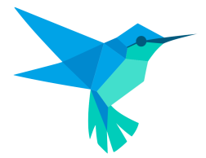
What is Dart? [1-2]
Dart is an open-source programming language developed by Google.
https://dartpad.dev/?
Dart SDK has the Dart Virtual Machine compiler and a utility called dart2js.
Dart is an object-oriented programming language. Thus, it has support for classes, polymorphism, interfaces, and abstraction.
Dart follows a C-style syntax. It is a multi-purpose language.

Slide 3
What is Dart? [2-2]
Dart is also a cross-platform or platform-independent programming language. This means that it can be run on several operating systems such as Windows, Linux, and MacOS.
Following are different types of applications that can be developed using Dart:
Web
Mobile
Desktop
Server

Slide 4




History of Dart
Started by Lars Bak
The Dart project was started by a Danish programmer who was popular for his work on virtual machines.
First edition Release
The first edition of Dart was released in July 2014, followed by the second edition in the next six months.
Evolution of Dart Compilers
dartc was the initial compiler. Later, it was Frog and finally it was dart2js.
The Success
dart2js was a success and still continues to be used in Dart for applications with optimal performance that can be built for multiple platforms.

Slide 5
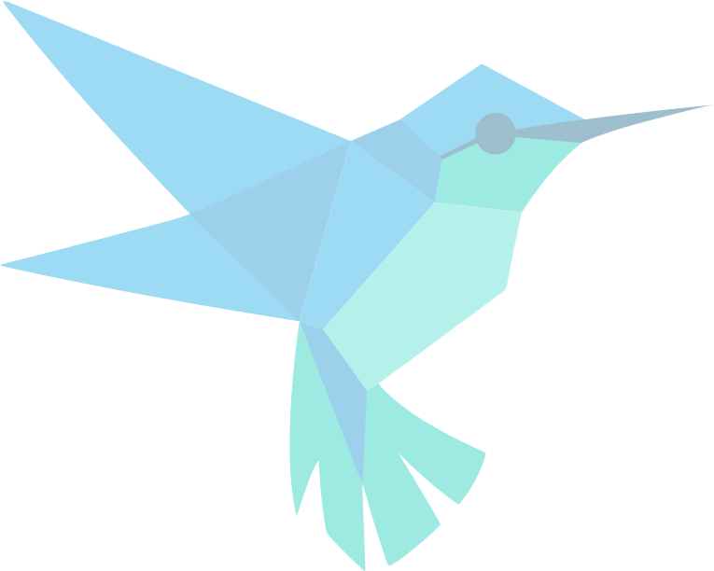

Features of Dart
Open Source
Extensive Libraries
Platform Independent
Browser Support
Object Oriented
Concurrency
Type Safe
Community
Easy to Learn
Flexible Compilation

Slide 6

Usage and Benefits of Dart
Universal code that works for several platforms such as Android, iOS, and Web browsers and does not require any change.
Detecting errors statically and code optimization.
Provides null safety, which results in lesser instances of app crash.
Dart is backed by Google.

Slide 7
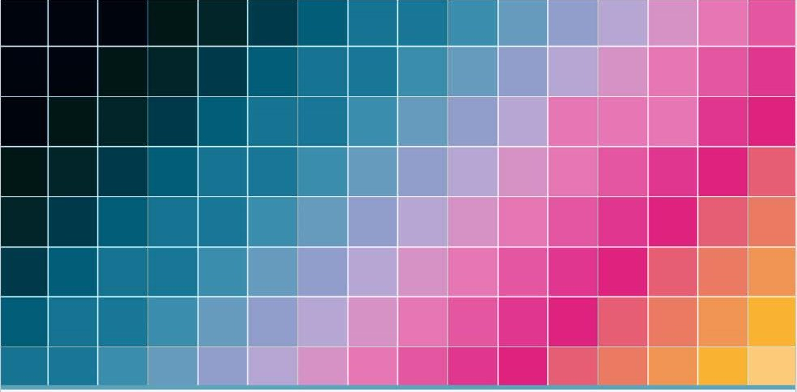
Steps to Install Dart SDK

Slide 8
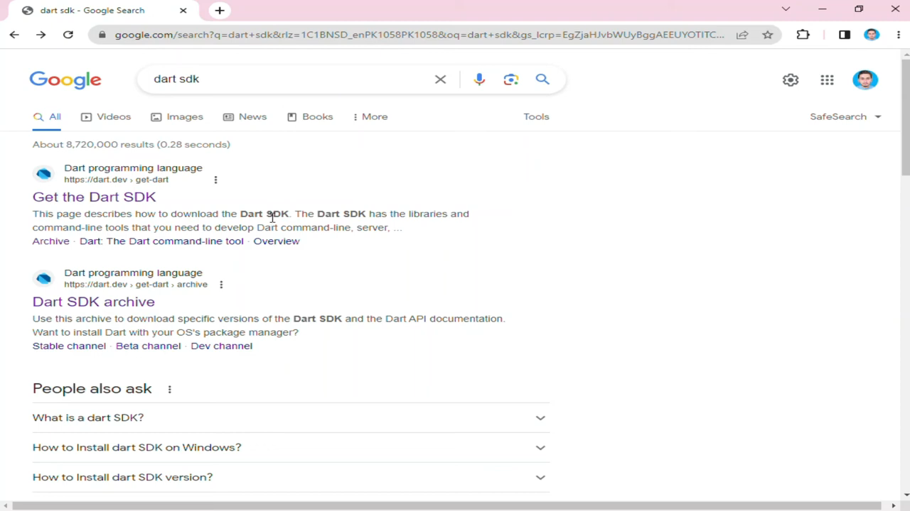
https://dart.dev/get-dart/archive

Slide 9
Understanding Basic Dart Syntax
The basic syntax in a Dart program comprises several elements such as keywords, data types, variables, constants, string literals, and symbols.
The main() method acts as an entry point to a Dart application.
A variable x is declared and assigned the data type int.
Another variable y is also declared and assigned as string.
void main(){
int x = 5;
string y = “Daniel”;
}

Slide 10
Identifiers in Dart
Rules for naming an identifier are as follows:
Can have $ and
_ as special characters
Can have a set of characters
Can start with an alphabet
Can start with an underscore
Cannot contain any spaces
Cannot start with a number
Cannot have keywords
Cannot be duplicated

Slide 11
Example of Identifiers in Dart
Valid Identifiers | Explanation | Invalid Identifiers | Explanation
firstName | Begins with lowercase | first Name | Space not allowed
first_name | Has underscore | first-name | Hyphen not allowed
sum1 | Begins with lowercase | Var | Begins with uppercase
_name | Begins with underscore (private variable) | 1name | Begins with a number

Slide 12
Keywords in Dart
Keywords in Dart are reserved words that the compiler interprets in a special manner.
Each keyword has a unique connotation and purpose in the Dart programming language.
Keywords are case-sensitive and cannot be used for naming variables, functions, and classes.
abstract | import | else | super | in | as | enum | switch
assert | export | interface | sync | async | extends | await | this
throw | library | break | continue | try | catch | final | class

Slide 13
Steps to Create a Simple Hello World Dart application

Slide 14
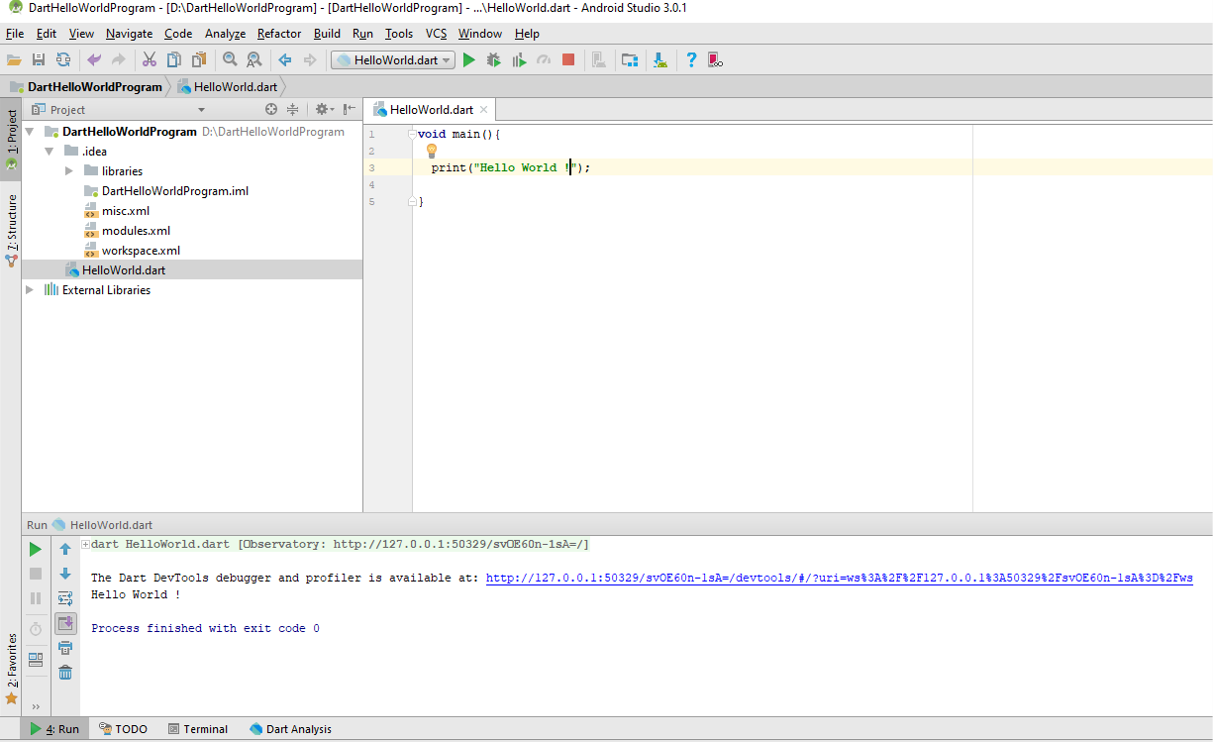
Output of the Hello World Dart Application

Slide 15
Summary
Dart is a client-centric open source language for developing applications at a faster pace across
several platforms.
The goal of Dart is to be the most fruitful programming language for development across multiple platforms.
Dart is designed to cater to client development while prioritizing sub-second stateful hot reloads as well as high-quality production across a wide variety of compilation targets (Web, mobile, and desktop).
Dart provides the language and runtimes that fuel Flutter applications.
Dart supports all modern browsers such as Chrome, Mozilla Firefox, and Internet Explorer for Web applications.
Dart program supports and backs multithreading by making use of isolates.

